Slide 1
Revamping Credit Card Operation
Johnny Chan Fan Hui

Slide 2
Recap of Bank’s Predicament
Current Default rate of 22.1% (bad debt of established banks are at 4%)
Affecting bottom line margin and hurting shareholders’ value
At the brink of security downgrade by Moody’s

Slide 3
Scope
01
Data Cleaning and Feature Engineering
02
Feature Selection
Data Preprocessing
03
04
Models training, predictive performance and selection
05
Discussion

Slide 4
01
Data Cleaning and Feature Engineering

Slide 5
Column Name | Feature Engineering 1 | Feature Engineering 2
Gender | Covert to categorical variables
Education
Martial Status | Covert to categorical variables
Age
Months of payment backlog | Obtain Max months of payment
Past payment | Subtraction from respective month to obtain unpaid balance per month. Thereafter, obtain Max unpaid balance | Division operation to obtain unpaid balance to credit limit ratio. Assumption: credit limit is relational to earning power and the ability to pay off debt
Past bill statement
Credit Limit
Default | Convert to years of ownership

Slide 6
02
Feature Selection

Slide 7
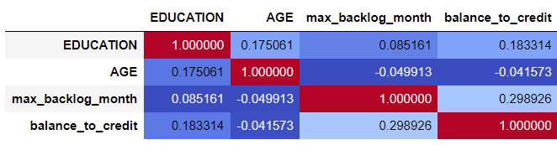
Numeric Variables
No two columns were strongly correlated. All columns were used

Slide 8
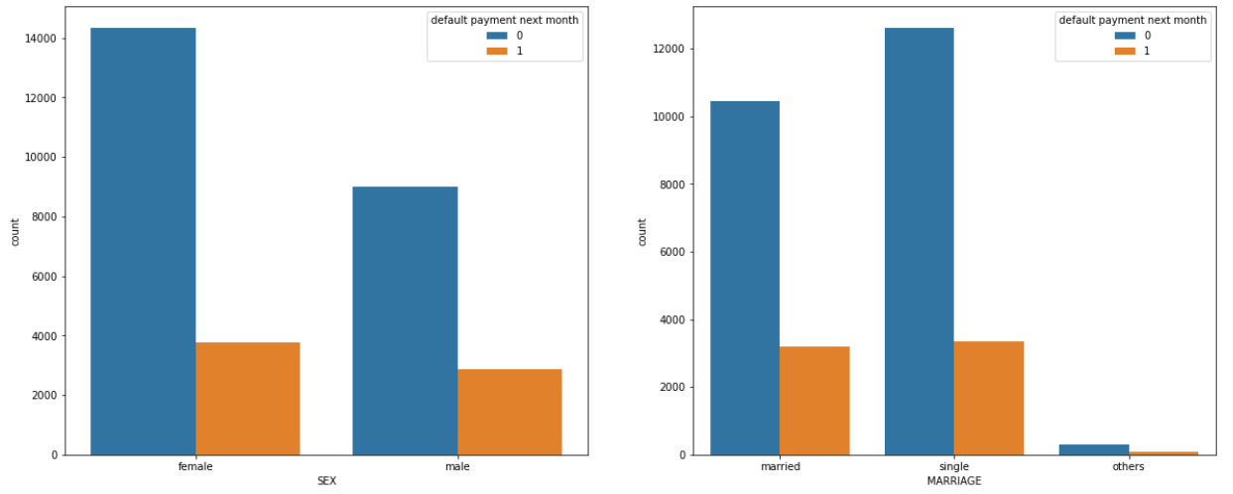
Categorical Variables
No single level dominated all default cases. Very little chance of model using the level as key predictor. Hence, all categorical variables were retained

Slide 9
03
Data Preprocessing

Slide 10
Pre-processing Steps
1
Balance dataset
Defaulted client is only 22.1% of dataset. Bootstrapping is done to increase defaulters to 50% of dataset
2
One hot encoding categorical variables
3
Train-Test split
4
Feature scaling of numerical variables

Slide 11
04
Models training and predictive performance

Slide 12
Model Performance
Ensemble of all 3 models: 96% Accuracy
Ensemble of 3 models is recommended
Decision Tree
(87.1% Accuracy)
Logistic Regression
(69.7% Accuracy)
Random Forest
(88.3% Accuracy)
(201 trees)

Slide 13
05
Discussion

Slide 14

1. Drawbacks
We assume that the clients have consistent income. Loan default due to loss of job is not captured

Slide 15

2. Area of Improvement (time permitting)
Explore other method of ensemble such as bagging, stacking and boosting
With the geospatial data of home address, conduct web scrapping of the median home price in the region to proxy for loan amount
We can explore creating another model which aims to tune the interest rate to the client profile to minimize default rate and maximize revenue

Slide 16
Thank you

